Slide 1

Chapter 8
The Media

Slide 2
Introduction
Freedom of the press and an independent media are important dimensions of a liberal society and a necessary part of a healthy democracy.
“No government ought to be without censors,” said Thomas Jefferson, “and where the press is free, no one ever will.”

Slide 3
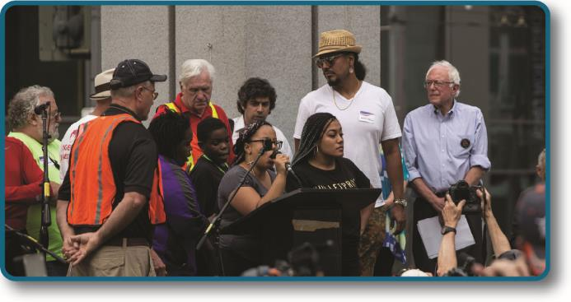
Figure 8.1
On August 8, 2015, activists for Black Lives Matter in Seattle commandeered presidential candidate Bernie Sanders’ campaign rally in an effort to get their message out. (credit: modification of work by Tiffany Von Arnim)

Slide 4
What is Media?
The term media defines a number of different communication formats from television to print.
The collection of all forms of media that communicate information to the public is called mass media, including television, print, radio, and internet.
We expect the media to cover important political and social events in a concise and neutral manner.
The work of the news media differs from public relations, which is communication designed to improve the image of companies, organizations, or candidates. Public relations is not a neutral information form.

Slide 5
Functions of Media
The media exist to fill a number of functions. Whether the medium is a newspaper, a radio broadcast, or a television newscast, a corporation behind the scenes must bring in revenue to pay for production.
The media are also watchdogs of society and of public officials.
Some refer to the media as the fourth estate, with the branches of government being the first three estates and the media equally participating as the fourth. This role helps maintain democracy and keeps the government accountable for its actions.

Slide 6
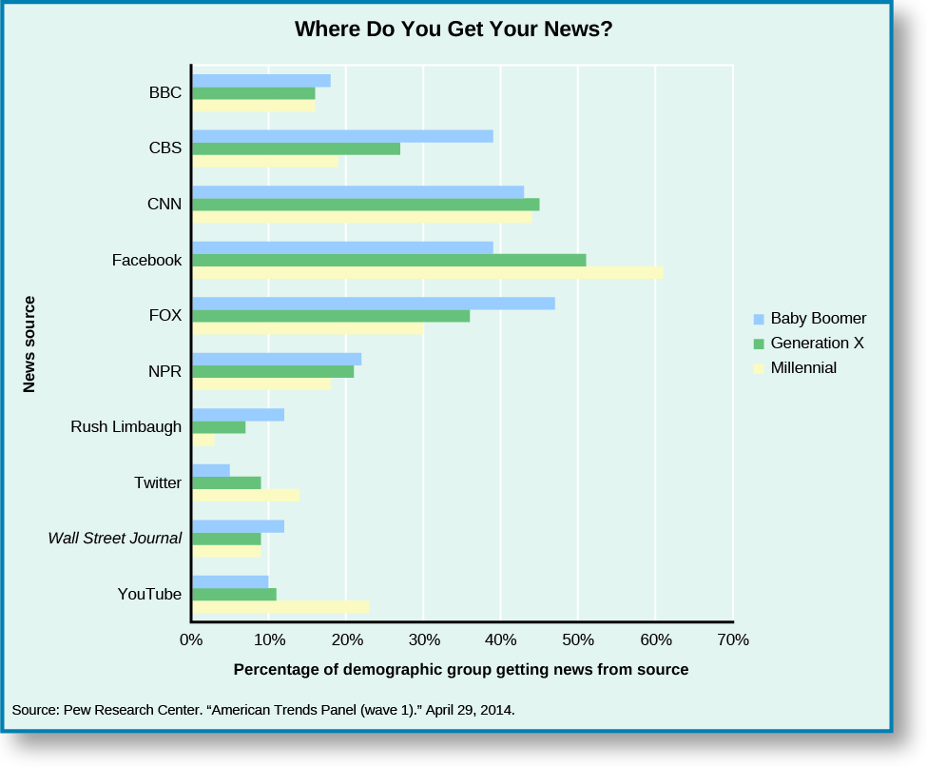
Figure 8.2
Age greatly influences the choice of news sources. Baby boomers are more likely to get news and information from television, while members of generation X and millennials are more likely to use social media.

Slide 7
More Functions of Media
The media also engages in agenda setting, which is the act of choosing which issues or topics deserve public discussion.
Before the internet, traditional media determined whether citizen photographs or video footage would become “news.”
The media also promote the public good by offering a platform for public debate and improving citizen awareness. Network news informs the electorate about national issues, elections, and international news.

Slide 8
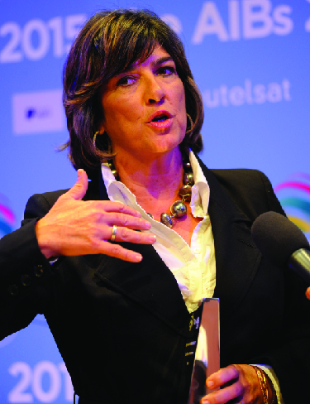
Figure 8.4
Christiane Amanpour accepts the award for the Association for International Broadcasting’s Personality of the Year on November 4, 2015. (credit: AIB (Association for International Broadcasting))

Slide 9
Media Formats and Audiences
Each form of media has its own complexities and is used by different demographics.
Age greatly influences the choice of news sources:
Millennials (born early 1980s to early 2000s) and Generation X (early 1960s to early 1980s) are more likely to get news and information from social media, such as YouTube and Twitter.
Baby boomers (born early 1940s to early 1960s) are most likely to get their news from television.

Slide 10
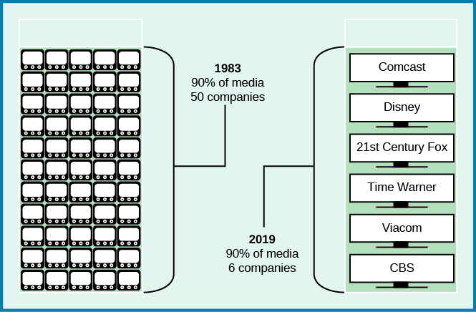
Figure 8.3 (2019 version)
In 1983, fifty companies owned 90 percent of U.S. media. By 2019, just six conglomerates controlled the same percentage of U.S. media outlets. And by 2021 it was down to 4 (next slide).

Slide 11
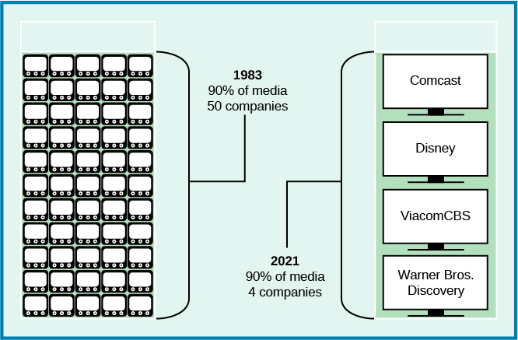
Figure 8.3 – 2021

Slide 12
History of Major Media Formats, Part 1
Early news was presented to local populations through the print press. After the Revolutionary War, a change occurred and the nation moved into the party press era, in which partisanship and political party loyalty dominated the choice of editorial content. Between 1830 and 1860, machines and manufacturing made the production of newspapers faster and cheaper.

Slide 13
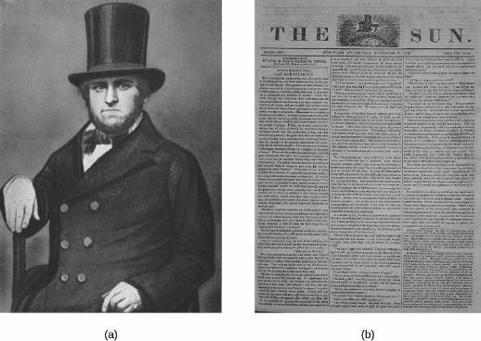
Figure 8.6
Benjamin Day (a) founded the first U.S. penny press, The Sun, in 1833. The Sun, whose front page from November 26, 1834, is shown above (b), was a morning newspaper published in New York from 1833 to 1950.

Slide 14
History of Major Media Formats, Part 2
Radio news made its appearance in the 1920s. The proliferation of the radio brought communications to rural America. Politicians realized that the medium offered a means of reaching the public in a personal way.
World War II changed radio news forever. The need and desire for frequent news updates about the war made newspapers, with their once-a-day printing, too slow. People wanted to know what was happening, and they wanted to know immediately.

Slide 15
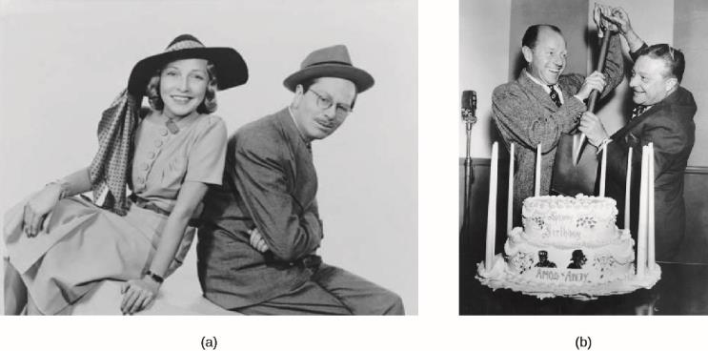
Figure 8.7
The “golden age of radio” included comedy shows like Easy Aces, starring Goodman and Jane Ace (a), and Amos ’n’ Andy, starring Freeman Gosden and Charles Correll, shown here celebrating their program’s tenth anniversary in 1938 (b). These programs helped amuse families during the dark years of the Depression.

Slide 16
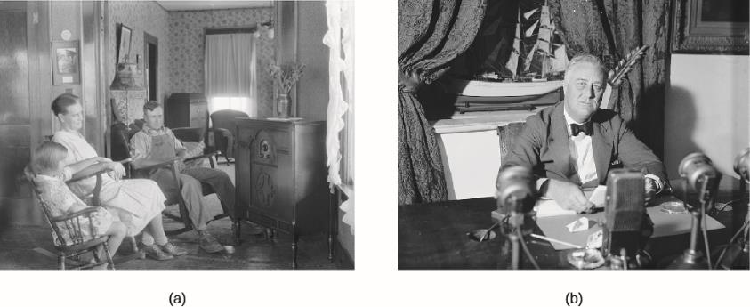
Figure 8.8
As radio listenership became widespread in the 1930s (a), President Franklin D. Roosevelt took advantage of this new medium to broadcast his “fireside chats” and bring ordinary Americans into the president’s world (b). (credit a: modification of work by George W. Ackerman; credit b: modification of work by the Library of Congress)

Slide 17
History of the Major Media Formats, Part 3
Television combined the best attributes of radio and photos and changed media forever. The first official broadcast in the United States was President Franklin Roosevelt’s speech at the opening of the 1939 World’s Fair in New York.
Even more than radio, television allowed politicians to connect with voters in deeper ways. Before television, few voters were able to see a president or candidate speak or answer questions in an interview.
Presidents often use television to reach citizens and gain support for policies, and to inspire and comfort the populace during national emergencies.

Slide 18
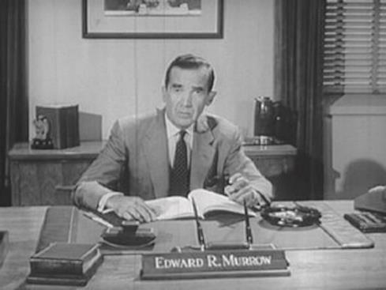
Figure 8.9
Edward R. Murrow’s move to television increased the visibility of network news. In The Challenge of Ideas (1961) pictured above, Murrow discussed the Cold War between the Soviet Union and the United States alongside films stars such as John Wayne.

Slide 19
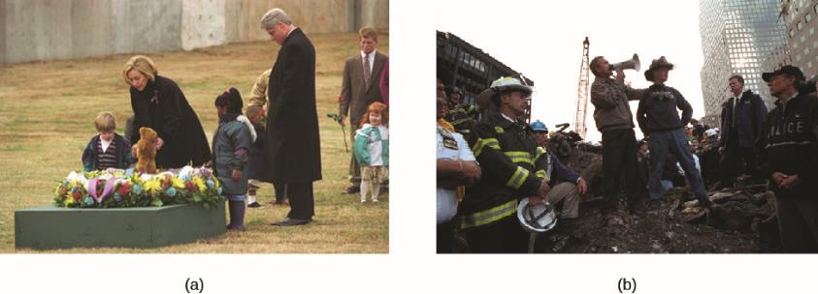
Figure 8.10
Presidents Clinton and Bush were both called upon to calm the people after mass killings. In April 1996, President Bill Clinton and First Lady Hillary Rodham Clinton lay flowers at the site of the former Alfred P. Murrah federal building just before the one-year anniversary of the Oklahoma City bombing (a). Three days after the terrorist attacks of 9/11 brought down the World Trade Center in New York City, George W. Bush declares to the crowd, “I can hear you! The rest of the world hears you! And the people . . . and the people who knocked these buildings down will hear all of us soon!” (b)

Slide 20
New Media Trends
The introduction of cable and expansion of the internet have inundated the public with information. Alternatives to watching network news now exist and the public can avoid politics altogether if they choose.
Social media is credited as one of the primary factors in the successful election campaign of President Barack Obama.

Slide 21
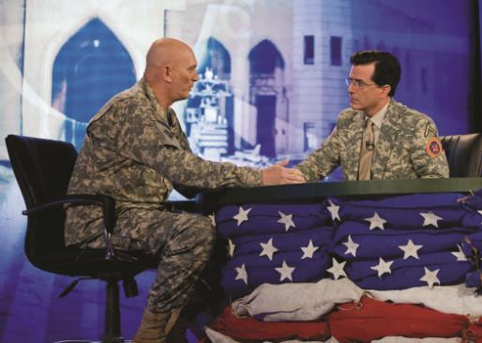
Figure 8.11
In June 2009, Stephen Colbert of The Colbert Report took his soft news show on the road, heading to Iraq for a week. During the first episode, Colbert interviewed Ray Odierno, commanding general of the coalition forces stationed in Iraq. (credit: The U.S. Army)

Slide 22
How Citizens Gain Information from the Media
The availability of the internet and social media has moved some control of the message back into the hands of the president and candidates. Politicians can now connect to the electorate directly, bypassing journalists.
Social media, such as Facebook, has also placed journalism in the hands of citizens: citizen journalism occurs when citizens use their personal recording devices and cellphones to capture events and post them on the internet.
Preferred programming that is humorous attracts younger viewers and has demonstrated that news can win young viewers if delivered well. This “soft news” presents content in an entertaining and approachable manner.

Slide 23
Forms of News Coverage Bias
Framing is the creation of a narrative or context for a news story.
Episodic framing occurs when a story focuses on isolated details or specifics, rather than looking broadly at the whole issue.
Thematic framing takes a broad look at an issue and skips the numbers or details.
Racial framing occurs when a person or group is represented in a negative or assumptive light
Priming is when media coverage predisposes the viewer or reader to a particular perspective on a subject or issue.

Slide 24
Media Influence
The media choose what they want to discuss. This agenda-setting creates a reality for voters and politicians that affects the way people think, act, and vote.
For example, regarding racial framing:
When survey respondents were shown a story of a White unemployed individual, 71 percent listed unemployment as one of the top three problems facing the United States.
When respondents were shown a story of a Black unemployed individual, only 53 percent listed unemployment as one of the top three problems facing the United States.

Slide 25
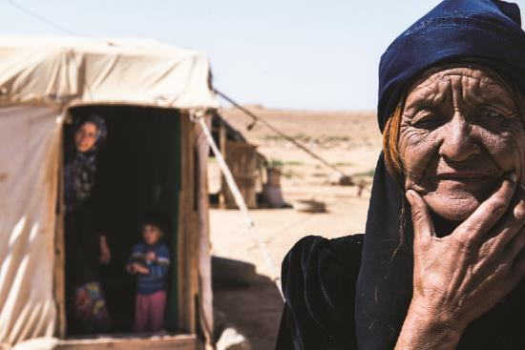
Figure 8.16
Civil war in Syria has led many to flee the country, including this woman living in a Syrian refugee camp in Jordan in September 2015. Episodic framing of the stories of Syrian refugees, and their deaths, turned government inaction into action. (credit: Enes Reyhan)

Slide 26
Government Oversight and Influence, Part 1
Media and FCC Regulations: The liberties enjoyed by newspapers are overseen by the U.S. court system, while television and radio broadcasters are monitored by both the courts and a government regulatory commission.
The FCC enforces ownership limits to avoid monopolies and censors material deemed inappropriate. It has no jurisdiction over print media, mainly because print media are purchased and not broadcast.

Slide 27
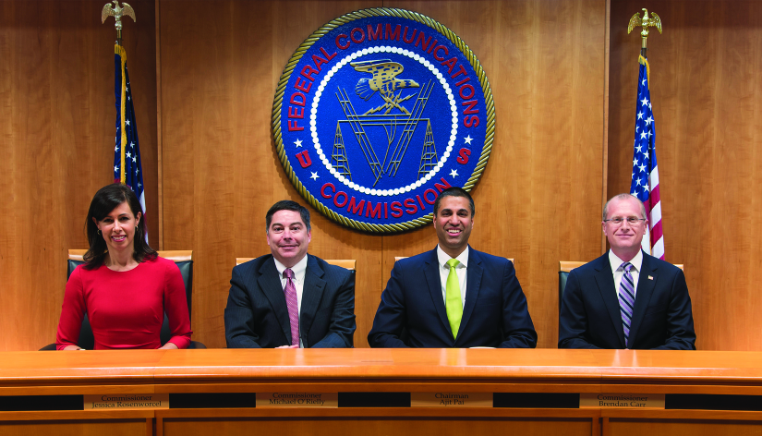
Figure 8.13
In June 2018, the leadership of the FCC included (from left to right) Jessica Rosenworcel, Michael O'Rielly, Ajit Pai, and Brendan Carr. (credit: Federal Communications Commission)

Slide 28
Government Oversight and Influence, Part 2
The FCC also maintains indecency regulations over television, radio, and other broadcasters, which limit content considered indecent and keep the public airwaves free of obscene material.
The equal time rule states that registered candidates running for office must be given equal opportunities for airtime and advertisements at non-cable television and radio stations beginning forty-five days before a primary election and sixty days before a general election.

Slide 29
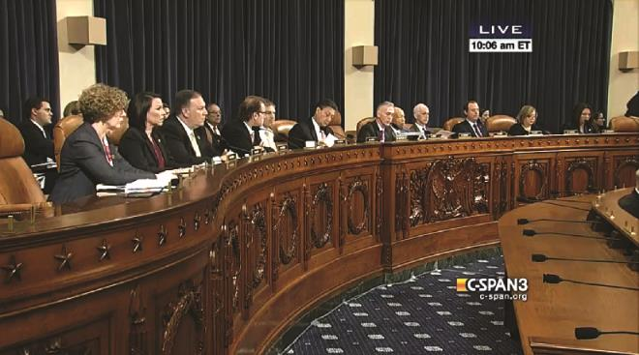
Figure 8.14
On October 22, 2015, the House Select Committee on Benghazi listened to testimony from former Secretary of State Hillary Clinton for close to eleven hours.

Slide 30
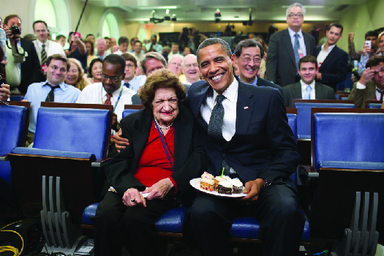
Figure 8.15
President Barack Obama and White House correspondent Helen Thomas set aside their differences over transparency to enjoy cupcakes in honor of their shared birthday on August 4, 2009.

Slide 31
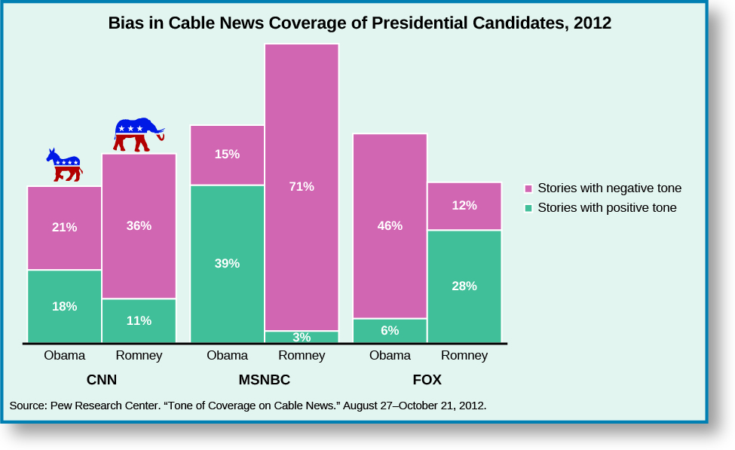
Figure 8.17
Media coverage of campaigns is increasingly negative, with cable news stations demonstrating more bias in their framing of stories during the 2012 campaign.

Slide 32
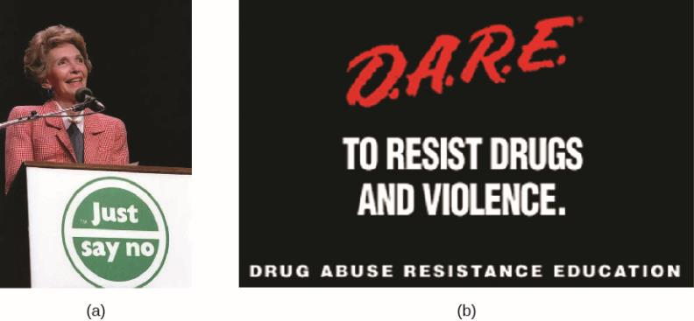
Figure 8.18
First Lady Nancy Reagan speaks at a “Just Say No” rally in Los Angeles on May 13, 1987 (a). The Drug Abuse Resistance Education (D.A.R.E.) is an anti-drug, anti-gang program founded in 1983 by a joint initiative of the Los Angeles Police Department and the Los Angeles Unified School District.

Slide 33
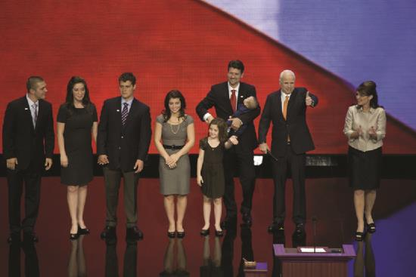
Figure 8.19
When Sarah Palin found herself on the national stage at the Republican Convention in September 2008, media coverage about her selection as John McCain’s running mate included numerous questions about her ability to serve based on personal family history. Attacks on candidates’ families lead many women to postpone or avoid running for office. (credit: Carol Highsmith)

Slide 34
Exceptions to Freedom of the Press
Slander and libel: The media do not have the right to commit slander (speak false information with an intent to harm a person or entity), or libel (print false information with an intent to harm a person or entity).
Classified material: The media have only a limited right to publish material the government designates as classified.

Slide 35
This OpenStax resource is Copyright 2021, Rice University. Significant portions of the text and outlines within these lecture slides were developed or compiled by Macmillan Learning to support OpenStax American Government, and provided to the community under a Creative Commons Attribution 4.0 License. Photos and illustrations are usually credited to their source. Where they are not, illustrations are Copyright 2021, Rice University, and also provided under a Creative Commons Attribution 4.0 License.

